Slide 1

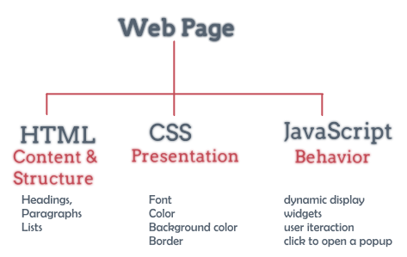
Basic concepts of Network and Internet

Slide 2
Lesson Objectives
Understand basic concepts, terms about networks, internet
Understand how a webserver works, so you can know how to configure the webserver
Know how to effectively exploit and search for information online

Slide 3
Lesson content
History of the Internet
Basic Concepts
Exploiting resources on the Internet

Slide 4
History of the Internet
The Internet originates from the American ARPANET network (1969) - a network between universities
1989 -Tim BernersLee invents the World Wide Web protocol, then creates Hypertext Markup Language –HTML
1990–Tim writes the first browser (Web Browser) and Web server (info.cern.ch)
Since 1993 the internet has developed very quickly
Vietnam had the official Internet in November 1997

Slide 5
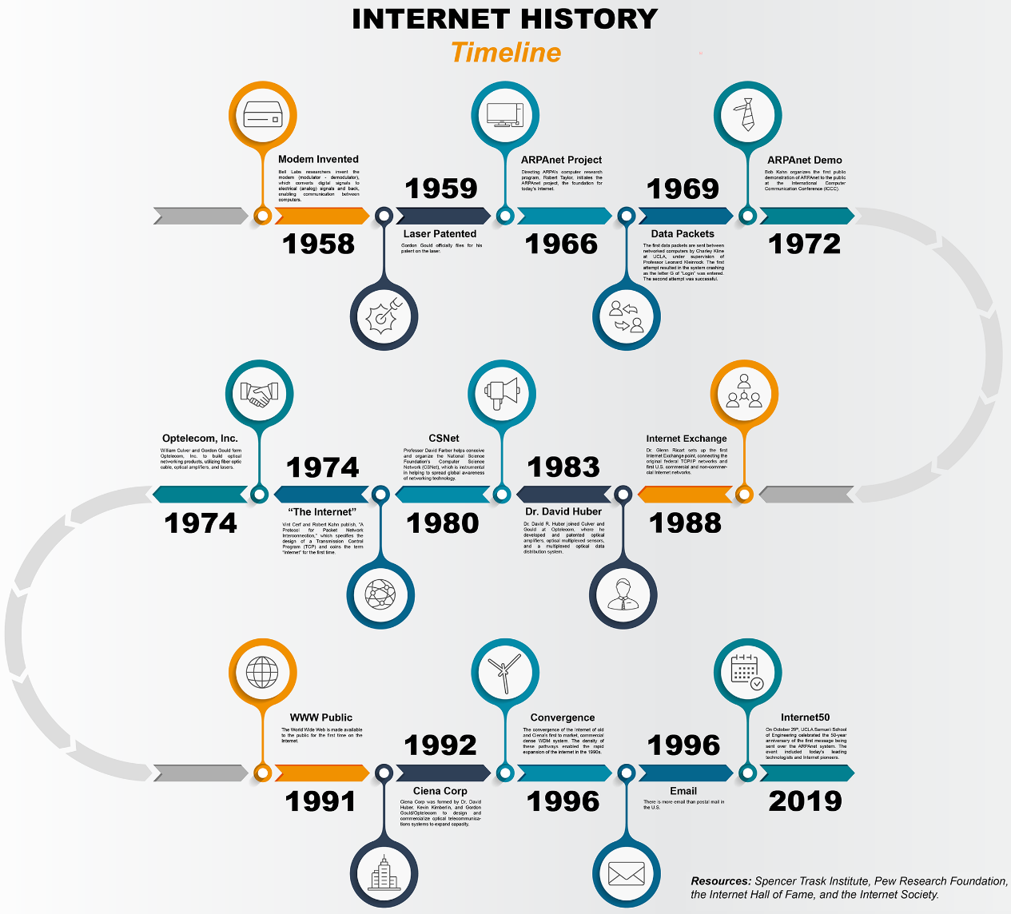
History of the Internet

Slide 6
Basic Concepts
Computer network Server Client Network Protocol (Protocol) IP Address Domain name URL Service port | Website, web page World Wide Web (WWW) Web server Web browser Static Web – Dynamic Web Some other important terms

Slide 7
Computer network
A computer network is a system of two or more computers that are connected to each other for the purpose of exchanging information and data.
Server - Client:
In a computer network, a computer that is used by other computers to access it is called a server.
The computers that access the server are called clients.

Slide 8
Server
A server is a computer that provides resources and services to other computers.
Usually installed with specialized software to be able to provide
Server with high configuration, stable performance
A server can be used for one or more purposes. The hostname is usually associated with the intended use.
For example:
File server
Application server
Mail server
Web server

Slide 9
Client
The client is the machine that exploits the server's service
For each service, there is usually specialized software to support the exploitation
A computer can be both a client and a server: Can exploit its own service.

Slide 10
Internet Protocol
A network protocol suite is a set of general rules that define the process of transmitting data between computers, so that the transmitted data is received correctly.
The protocol determines the communication process in the network and most importantly defines the "shape" of a data unit and the information contained in it so that the destination computer can transform the information correctly.
Data is transmitted from the application on this machine, through the hardware to the network of the machine, to the intermediary and to the receiver, through the hardware of the destination computer, and to the application.

Slide 11
Internet Protocol
Some common network protocols:
TCP/IP (Transmission Control Protocol/ Internet Protocol) :
It is a protocol system - a set of protocols that support the transmission of data over a network
TCP/IP and related protocols create a complete system that manages how data is processed, transferred, and received over a network using TCP/IP. A system of related protocols, such as TCP/IP, is called a protocol suite.

Slide 12
Internet Protocol
FTP: (File Transfer Protocol)
Used to transfer documents from one computer to another over the Internet.
Upload: transfer files from a workstation to a file store, a document storage computer,
Download: used to transfer files from the file store to a workstation.
FTP is often used to load web pages from designers to servers.
Commonly used software: FileZilla, WinSCP, …

Slide 13
Internet Protocol
HTTP (HyperText Transfer Protocol):
HTTP's main task is to transfer the content of a web page into a browser for web visitors to view.
A protocol used to transfer files from a web store into a browser so that the user can view the web page on the internet.

Slide 14
Internet Protocol
HTTPS (Hypertext Transfer Protocol Secure):
This Protocal is a combination of the HTTP protocol and the SSL or TLS security protocol that allows the secure exchange of information on the Internet. HTTPS protocol is often used in sensitive transactions that need high security.

Slide 15
Internet Protocol Address
An IP address is a 32-bit number used to identify objects that receive and send information and data on the network.
Each device on the network has its own IP address.
The IP address is in the form of 4 digits (8 bits each), these 4 numbers are separated by a ".". Example: 192.168.2.135
Currently deploying IPv6

Slide 16
Internet Protocol Address
IPv4: a.b.c.d (0<a,b,c,d<255)
For example: website address of University of Economics and Law, VNU-HCM City. HCM is:
www.uel.edu.vn corresponding IP is 125.234.104.249
To know the IP address of the website we do the following:
Start → Run → CMD → type Ping www.uel.edu.vn and press enter.
Address: 127.0.0.1 (localhost) is the address of the computer itself, which is often used to test networks and test websites.

Slide 17
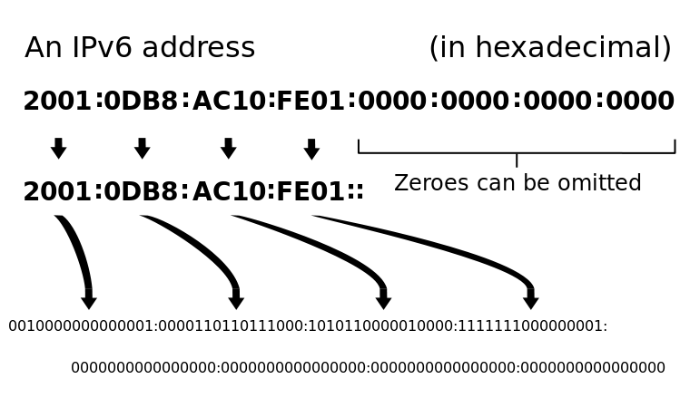
Internet Protocol Address
IPv6
128bits
Format: 8 groups of hexadecimal numbers

Slide 18
Domain name
Domain name can be seen as the transaction name of a company or organization on the Internet.
The domain name is associated with an IP address
Because the domain name is in text form, the domain name is friendly and easy to use.
Having a domain name makes it easier to access resources on the Internet.

Slide 19
Domain name
Domain names are divided into several levels, each level is separated by a "." and are numbered from right to left, starting at level 1.
For example: uel.edu.vn
vn: Vietnam (level 1)
edu: Educational institution (level 2)
uel: Company/Organization name (level 3)

Slide 20
Domain name
Some common first-level domains:
.com: commercial company
.edu: schools, educational institutions.
.net: networks
.int: international organizations
.org: other organizations
To own a domain name we must contract and pay an annual fee. If ownership expires but we do not continue the contract and pay the cost, this domain name may be acquired by someone else.

Slide 21
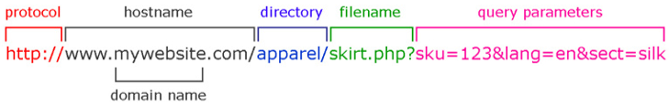
URL
URL-Uniform Resource Locator
URLs are unique identifiers for Internet resources
URL Indicates :
How to access
Resource location
General syntax:
protocol://host_name[:port_num][/path][/file_name]

Slide 22
Service port
This is an integer between 0 and 65535 that identifies the server's service.
Each protocol or service will carry a specific port.
VD:
Web : use port 80
Ftp: use port 21.

Slide 23
web, web site
Web (Web page):
Web page is a content page that displays information and data in the form of text, audio, images, ..
A web page can be written in many different languages: php, asp, aspx… but the result returned to the client is HTML (Hypertext Markup Language).
Web site:
A collection of websites of organizations or individuals on the network with unified content serving a certain purpose.

Slide 24
World Wide Web (WWW)
WWW is a collection of web sites on the internet.
WWW is the most popular service on the Internet. To get this service users need to have a web browser (web browser).

Slide 25
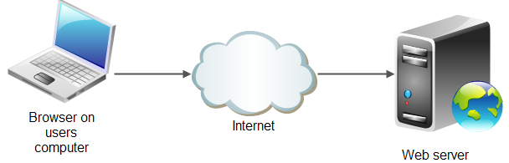
Web server
A web server is software and hardware that uses HTTP and other protocols to respond to client requests made over the World Wide Web. The main job of a web server is to display website content through storing, processing and delivering webpages to users.
Some specialized web server software:
Apache: open source
Internet Information Services (IIS): Product of Microsoft

Slide 26
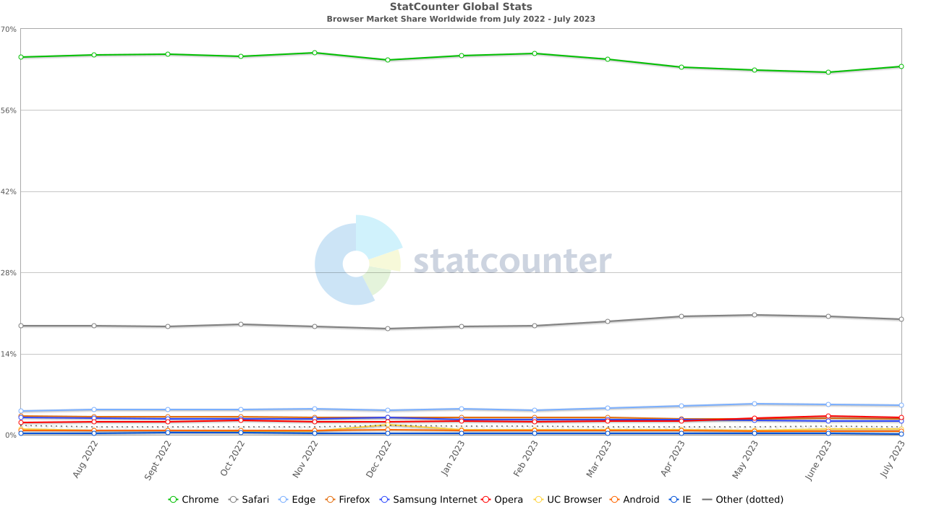

Web browser
Web Browser:
Software running on the client computer used to display web pages and help exploit web services. Some typical Web browsers:

Slide 27
Static Web – Dynamic Web
Static Web:
Easy to program
Interaction with weak web browser
Use HTML language to design
Static web creators often use visual tools to create websites such as FrontPage, Notepad...
Do not receive feedback from users.

Slide 28
Static Web – Dynamic Web
Dynamic Web :
More difficult to develop
Interact with strong web browsers
Use different languages for programming
Often have to write a lot of code
Get feedback from users.

Slide 29
Some other important terms
IAP (Internet Access Provider)
ISP (Internet Service Provider). Some current ISPs in Vietnam: VDC, FPT, Viettel, ...

Slide 30
Exploiting resources on the Internet
Look up information
www.google.com
http://www.wikipedia.org/
http://scholar.google.com/

Slide 31
Exploiting resources on the Internet
Social network
https://www.facebook.com/
https://www.linkedin.com/
https://twitter.com/

Slide 32
Exploiting resources on the Internet
Daily News
http://tuoitre.vn/
http://vnexpress.net/
http://www.dantri.com.vn/
http://www.thanhnien.com.vn/

Slide 33
Exploiting resources on the Internet
Research, science, education
www.codeproject.com
http://msdn.microsoft.com
www.programmersheaven.com
https://www.tutorialspoint.com/
https://www.kaggle.com/
Online shopping
Amazon (book sales) - www.amazon.com
eBay (Auction) - www.ebay.com

Slide 34
Exploiting resources on the Internet
Dowload Website Offline
http://www.httrack.com/
Download File
FlashGet – www.flashget.com
Internet Download Manager - www.internetdownloadmanager.com

Slide 35
Exploiting resources on the Internet
Searching:
Google
Bing
https://www.wolframalpha.com/
Copernic – www.copernic.com: support smart search on multiple Search Engines at the same time, and remove duplicate results

Slide 36


Hey! Coding is easy!
END

